Slide 1
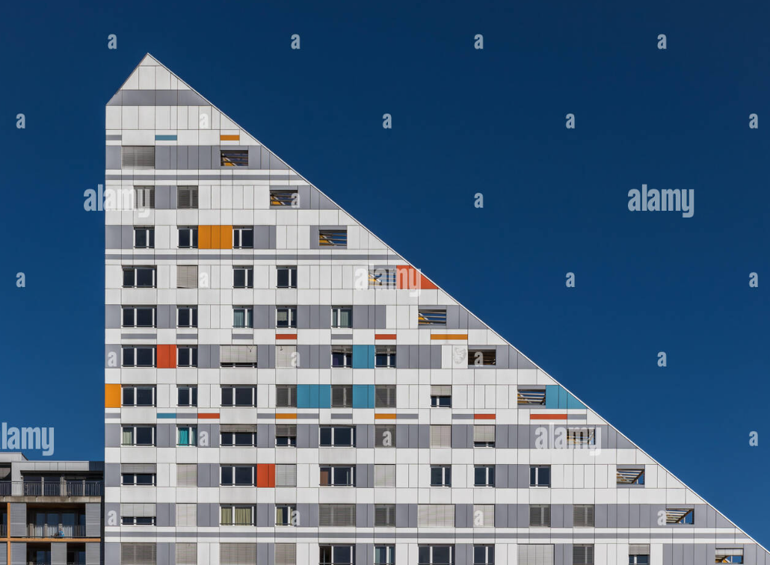
Bonus: Sperner’s Lemma and the Rental Harmony Theorem

Slide 2
A Warmup Proof
Place points on a line segment, and color each point either red or blue.
Only Rule: points at either end must be differently colored.
Theorem:
There exists a pair of adjacent points that are differently-colored.
In fact, there are an odd number of such pairs.

Slide 3
Sperner’s Lemma is the generalization to 2d and beyond
Place points to subdivide a big triangle into smaller triangles.

Slide 4
Sperner’s Lemma is the generalization to 2d and beyond
Place points to subdivide a big triangle into smaller triangles.
Color each point red, blue, or green.
Only Rule: one side is non-red, one side is non-blue, and one side is non-green.
Theorem:
There exists a triangle of adjacent points that are all differently-colored.
In fact, there are an odd number of such triangles.
Non-green
Non-red
Non-blue

Slide 5
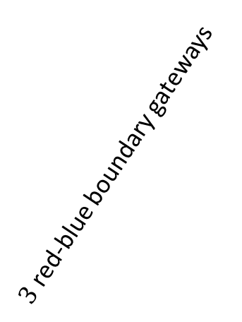
Sperner’s Lemma is the generalization to 2d and beyond
Theorem:
In any valid coloring, there exists a 3-colored triangle.
Proof:
Choose your least favorite color. (We’ll use green.)
Line segments of the other two colors (red-blue) are “gateways.”
Take a walk through the triangle, only moving through gateway edges.
Some walks will exit the triangle. These use up 2 boundary gateways.
Some walks will dead end in the triangle. These end at a 3-colored triangle!
$3$ red-blue boundary gateways
There are an odd # of red-blue boundary gateways, by previous proof.
So we must get at least one dead-end walk!

Slide 6
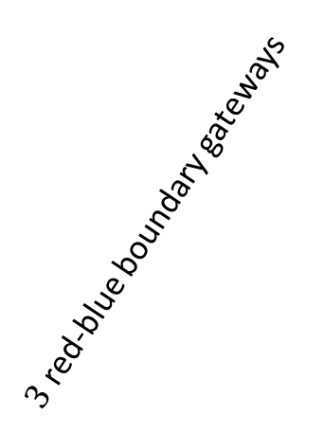
Sperner’s Lemma is the generalization to 2d and beyond
Theorem:
In any valid coloring, there are an odd number of 3-colored triangles.
Proof:
Take a walk through the triangle, only moving through red-blue gateway edges.
Some walks will exit the triangle. These use up 2 boundary gateways.
An odd # walks will dead end in the triangle. These end at a 3-colored triangle!
What if we missed a 3-colored triangle?
Start a new walk from that triangle
Walk can’t exit the triangle (we used all the boundary gateways already)
So it must end at another 3-colored triangle
$3$ red-blue boundary gateways
Remaining 3-colored triangles come in pairs.

Slide 7
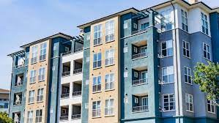
The Rental Harmony Theorem
Alice, Bob, and Charlie need to share a 3-bedroom apartment.
Rent is $3000/month.
Rooms are painted red, blue, green
Rooms are distinct, and they might have different preferences on the rooms.
Goal: assign each person a room, and a portion of rent, in a way that is “fair.”
Assumption: Everyone prefers free rooms to paid rooms.
Rental Harmony Theorem:
It is possible to assign Alice, Bob, Charlie rooms and rent contributions, so that nobody prefers another’s assignment to their own.
We will prove “approximate version” – everyone is within $1 month/rent of preferring their assignment to the others.

Slide 8
The Rental Harmony Theorem
The possible rent allocations can be arranged in a triangle.
Divide it into subtriangles, so that adjacent points differ by at most $1 rent for each room.
(many more than pictured here)
Red: $0
Blue: $3000
Green: $0
Red: $3000
Blue: $0
Green: $0
Red: $0
Blue: $0
Green: $3000

Slide 9
The Rental Harmony Theorem
The possible rent allocations can be arranged in a triangle.
Divide it into subtriangles, so that adjacent points differ by at most $1 rent for each room.
(many more than pictured here)
Assign points to Alice/Bob/Charlie so that each subtriangle has points with all three owners.
At each point, ask the owner which room they prefer
Red: $0
Blue: $3000
Green: $0
A
B
C
C
A
B
A
B
C
A
Red: $3000
Blue: $0
Green: $0
Red: $0
Blue: $0
Green: $3000
B
C
A
B
C

Slide 10
The Rental Harmony Theorem
The possible rent allocations can be arranged in a triangle.
Divide it into subtriangles, so that adjacent points differ by at most $1 rent for each room.
(many more than pictured here)
Assign points to Alice/Bob/Charlie so that each subtriangle has points with all three owners.
At each point, ask the owner which room they prefer
Red: $0
Blue: $3000
Green: $0
A
At rent allocation of
Red: $500
Blue: $2000
Green: $500
what does Alice prefer?
B
C
C
A
B
A
B
C
A
Red: $3000
Blue: $0
Green: $0
Red: $0
Blue: $0
Green: $3000
B
C
A
B
C

Slide 11
The Rental Harmony Theorem
The possible rent allocations can be arranged in a triangle.
Divide it into subtriangles, so that adjacent points differ by at most $1 rent for each room.
(many more than pictured here)
Assign points to Alice/Bob/Charlie so that each subtriangle has points with all three owners.
At each point, ask the owner which room they prefer
Red: $0
Blue: $3000
Green: $0
A
At rent allocation of
Red: $500
Blue: $2000
Green: $500
what does Alice prefer?
B
C
C
A
B
A
B
C
A
Red: $3000
Blue: $0
Green: $0
Red: $0
Blue: $0
Green: $3000
B
C
A
B
C

Slide 12
The Rental Harmony Theorem
The possible rent allocations can be arranged in a triangle.
Divide it into subtriangles, so that adjacent points differ by at most $1 rent for each room.
(many more than pictured here)
Assign points to Alice/Bob/Charlie so that each subtriangle has points with all three owners.
At each point, ask the owner which room they prefer
Red: $0
Blue: $3000
Green: $0
A
At rent allocation of
Red: $2000
Blue: $500
Green: $500
what does Bob prefer?
B
C
C
A
B
A
B
C
A
Red: $3000
Blue: $0
Green: $0
Red: $0
Blue: $0
Green: $3000
B
C
A
B
C

Slide 13
The Rental Harmony Theorem
The possible rent allocations can be arranged in a triangle.
Divide it into subtriangles, so that adjacent points differ by at most $1 rent for each room.
(many more than pictured here)
Assign points to Alice/Bob/Charlie so that each subtriangle has points with all three owners.
At each point, ask the owner which room they prefer
Red: $0
Blue: $3000
Green: $0
A
At rent allocation of
Red: $2000
Blue: $500
Green: $500
what does Bob prefer?
B
C
C
A
B
A
B
C
A
Red: $3000
Blue: $0
Green: $0
Red: $0
Blue: $0
Green: $3000
B
C
A
B
C

Slide 14
The Rental Harmony Theorem
The possible rent allocations can be arranged in a triangle.
Divide it into subtriangles, so that adjacent points differ by at most $1 rent for each room.
(many more than pictured here)
Assign points to Alice/Bob/Charlie so that each subtriangle has points with all three owners.
At each point, ask the owner which room they prefer
Red: $0
Blue: $3000
Green: $0
A
At rent allocation of
Red: $500
Blue: $500
Green: $2000
what does Charlie prefer?
B
C
C
A
B
A
B
C
A
Red: $3000
Blue: $0
Green: $0
Red: $0
Blue: $0
Green: $3000
B
C
A
B
C

Slide 15
The Rental Harmony Theorem
The possible rent allocations can be arranged in a triangle.
Divide it into subtriangles, so that adjacent points differ by at most $1 rent for each room.
(many more than pictured here)
Assign points to Alice/Bob/Charlie so that each subtriangle has points with all three owners.
At each point, ask the owner which room they prefer
Red: $0
Blue: $3000
Green: $0
A
At rent allocation of
Red: $500
Blue: $500
Green: $2000
what does Charlie prefer?
B
C
C
A
B
A
B
C
A
Red: $3000
Blue: $0
Green: $0
Red: $0
Blue: $0
Green: $3000
B
C
A
B
C

Slide 16
The Rental Harmony Theorem
The possible rent allocations can be arranged in a triangle.
Divide it into subtriangles, so that adjacent points differ by at most $1 rent for each room.
(many more than pictured here)
Assign points to Alice/Bob/Charlie so that each subtriangle has points with all three owners.
At each point, ask the owner which room they prefer
Red: $0
Blue: $3000
Green: $0
A
Note: free rent assumption → sides are monocolor!
B
C
C
A
B
A
B
C
A
Red: $3000
Blue: $0
Green: $0
Red: $0
Blue: $0
Green: $3000
B
C
A
B
C

Slide 17
The Rental Harmony Theorem
The possible rent allocations can be arranged in a triangle.
Divide it into subtriangles, so that adjacent points differ by at most $1 rent for each room.
(many more than pictured here)
Assign points to Alice/Bob/Charlie so that each subtriangle has points with all three owners.
At each point, ask the owner which room they prefer
Red: $0
Blue: $3000
Green: $0
A
Note: free rent assumption → sides are monocolor!
B
C
C
A
B
A
B
C
A
Red: $3000
Blue: $0
Green: $0
Red: $0
Blue: $0
Green: $3000
B
C
A
B
C

Slide 18
The Rental Harmony Theorem
The possible rent allocations can be arranged in a triangle.
Divide it into subtriangles, so that adjacent points differ by at most $1 rent for each room.
(many more than pictured here)
Assign points to Alice/Bob/Charlie so that each subtriangle has points with all three owners.
At each point, ask the owner which room they prefer
Note: free rent assumption → sides are monocolor!
B
C
Trick: ignore the corner points
Now there is exactly one external edge for each color-pair
Choose a gateway (say red-blue) and start walking.
You used the only external gateway, so the path must end in a 3-colored triangle
This is a fair allocation (up to $1)!
C
A
B
A
B
C
A
C
A
B

Slide 19
Mechanism Design
The Rental Harmony Theorem is an example of mechanism design, a modern field on the boundary of computer science, economics (game theory), and law.
The goal is to write algorithms that set prices, allocate resources, write contracts, etc. in a way that is provably “fair.”
Definition of “fair” changes in context – this one was called “envy-freeness”
More on mechanism design in EECS 477, or in Econ/SI departments

